Slide 1
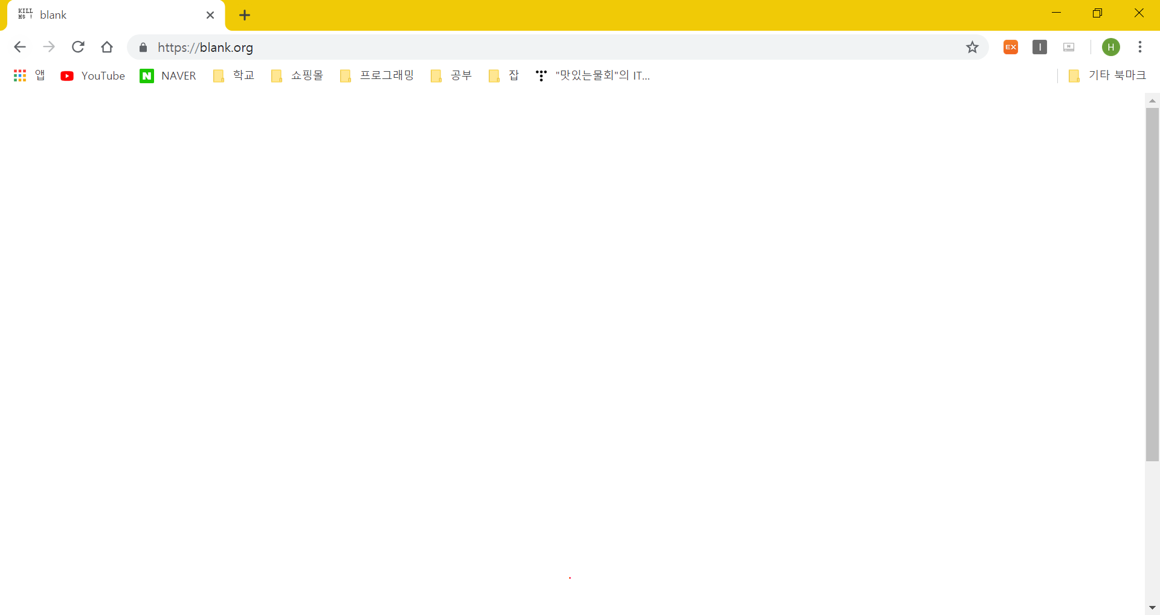
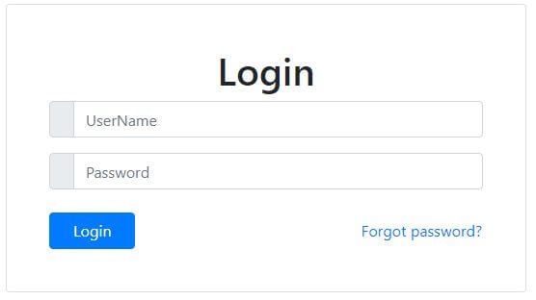

Slide 2
New lesson
My page

Slide 3
Professor
New lesson
S
Professor name : text
Subject name: text
Lesson name: text
Time : text
Add time table
New
lesson
register
Log in
New lesson
My page
E-learning
Enter
My
page
lessons
Java
C
Java
C
Edit
Edit
Enter
Edit
Delete

Slide 4
New lesson
Professor name
Subject name
Lesson name
Day / Time
Register

Slide 5
Professor
New lesson
S
Professor name : text
Subject name: text
Lesson name: text
Time : text
Add time table
New
lesson
register
Log in
New lesson
My page
E-learning
Enter
My
page
lessons
Java
C
Java
C
Edit
Edit
Enter
Edit
Delete

Slide 6
My lessons
Subject | Professor name | Lesson name | Day / Time | Check
Java | Dorz | Java basic | Mon 9:00 ~ 11:00
C | Dorz | C | Tue 15:00 ~ 17:00
Korean Speaking 1 | Dorz | Korean | Thu 13:00 ~ 15:00
Korean Speaking 2 | Dorz | Korean | Fri 15:00 ~ 17:00
Enter
Edit
Delete

Slide 7
My lesson
Professor name
Subject name
Lesson name
Day / Time
Edit

Slide 8
doc
screen
close
Student
Cam
T
O
O
L
Students
List
Chat

